Slide 1
MACHINE LEARNING PROJECT Leveraging Gradients for Testfunction Simulation with Support Vector Machines and Neural Networks
NH
Advanced Machine Learning | 08.09.2023 | WWIDS120
Timo Heiß, Nick Hillebrand, Pascal Knoll, Moritz Schlager, Tom Zehle

Slide 2
Contents
NH
Introduction
Experiment Design
Testfunction Simulation
Evaluation
Conclusion

Slide 3
01 Introduction
NH

Slide 4

1.1 Problem Description
NH
Real-world problems are not always readily available for benchmarking
Groundtruth functions may not be available
Groundtruth functions are too expensive (calculation time, etc.)
Groundtruth functions are confidential / should not be made available to the research community
Employ ML techniques to create testfunctions for optimization algorithms
Notes:
In Machine Learning, benchmarking is the methodology of comparing learnings or algorithms with respect to a certain performance measu
Viele Probleme aus der realen Welt sind für Benchmarking nicht immer ohne weiteres verfügbar. Dies kann unterschiedliche Ursachen haben. So köann es sein dass die entsprechenden Groundtruth Funktionen nicht verfügbar, zu teuer oder streng vertraulich sind.
==> gegebenenfalls drüber rauschen je nachdem in wiefern darauf in vergangenen Präsis eingegangen wurde.

Slide 5
1.2 Aim of the Investigation
NH
Objective: Create testfunctions that mimic a real-world objective function, allowing for accurate algorithm performance analysis under the following conditions:
Difficulty and non-smoothing: Testfunctions should be neither too easy nor too difficult to solve; test instances should reflect the ruggedness of the original problem
Costs: Low costs for the evaluation of the functions for accelerated experiments
Diversity: Attention is given to a diverse range of objective functions within a class
Flexibility: Testfunctions should reflect different classes of target functions
Relevance: Testfunctions should reflect real-world problem behavior
Zaefferer and Fischbach 2017;
Zaeffer, Aufgabenstellung zum Teilmodul: Machine Learning Project
Notes:
Ziel ist das Erstellen von Testfunktionen, die eine reale Zielfunktion approximieren und so eine genaue Analyse der Algorithmusleistung unter den folgenden Bedingungen ermöglichen:

Slide 6

1.3 Approach
NH
Data-driven: Collect data from a real process and then model it with a ML algorithm
Find a model that fits the problem and can act as testfunction based on the samples
Find evaluation measures that are suitable for evaluating the simulated functions
Notes:
Daten aus einem realen Problem sammeln und die zu grunde liegende Groudtruth fukntion mit Hilfe von ML approximieren. Dazu wird ein Model gesucht, dass als testfunktion basierend auf den gesammelten Daten fungieren kann. Abschließend müssen Evaluationsmetriken gefunden werden mit denen die approximierten Funktionen evaluiert werden können.

Slide 7
02 Experiment Design
NH

Slide 8
2.1 Workflow
NH
Ground Truth Function Selection
BBOB (Black-box Optimization Benchmarking) function suite
Sampling
Random
Model Selection & Training
Loss definition
Evaluation
Graphical (qualitative)
Metric-based (quantitative)
Optimization using different approaches (gradient, evolutionary, …)
Optimization-Based
Model Selection and training

Slide 9
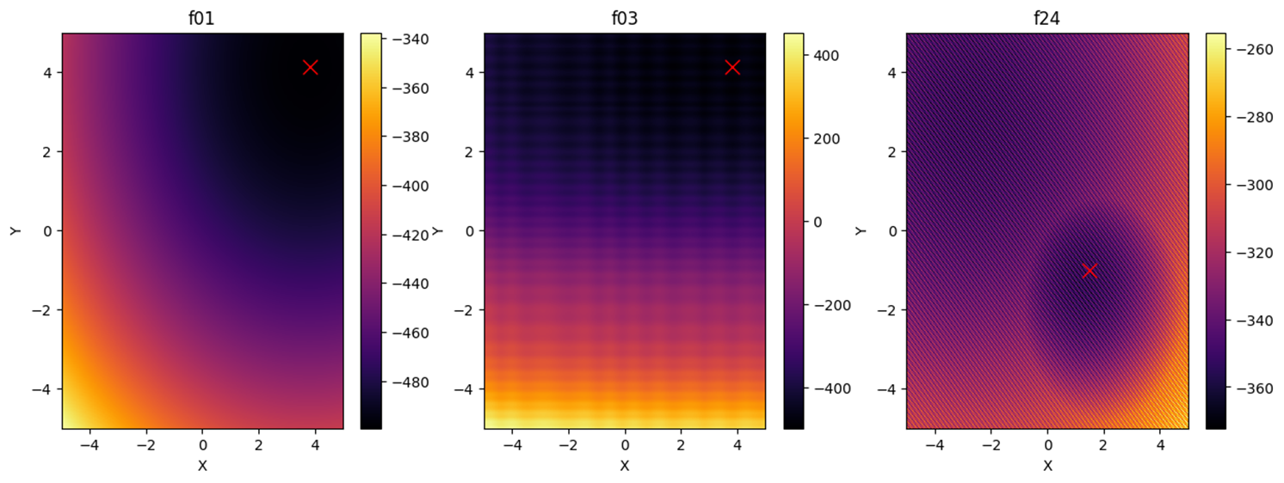
2.2 Groundtruth Function Selection
NH
BlackBox Optimization Benchmarking (BBOB) test suite as groundtruth functions
Restriction of the BBOB functions to F01, F03 and F24
Notes:
F01 hat keinerlei lokale Strukturen, f03 hat schon lokale Strukturen und f24 hat lokale strukturen und hat zusätzlich eine komplexere globale Struktur

Slide 10
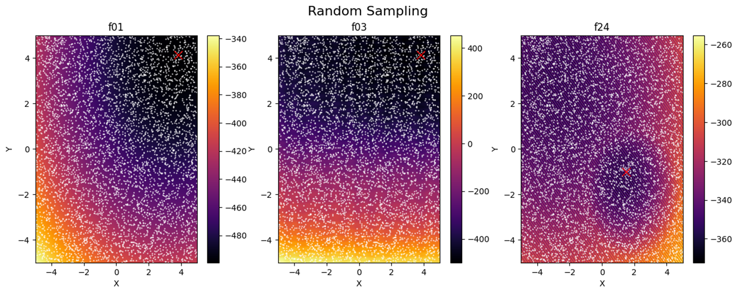
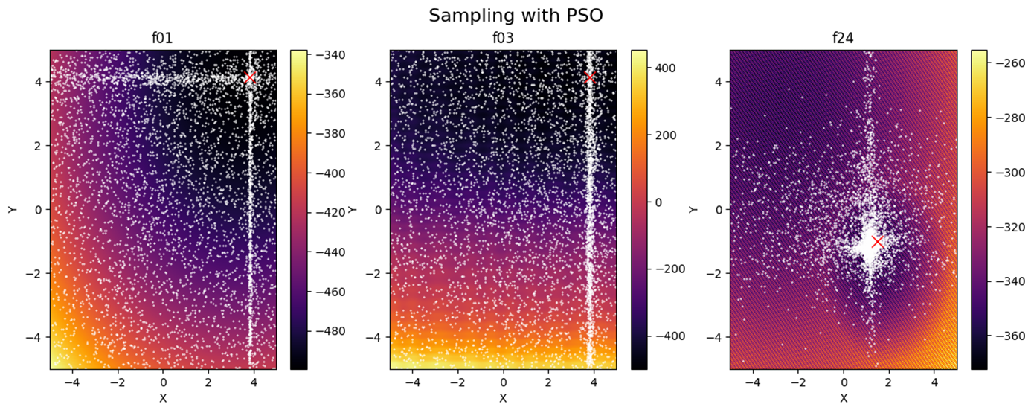
2.3 Sampling Strategy
NH
Considering Random Sampling and Particle Swarm Optimization as sampler
Draw 1000 samples (good trade-off between cost and information)
Conclusion: PSO parametrization is difficult such that the entire search space is covered sufficiently
Random Sampling is chosen for the following experiments

Slide 11
03 TestFunction Simulation
PK

Slide 12
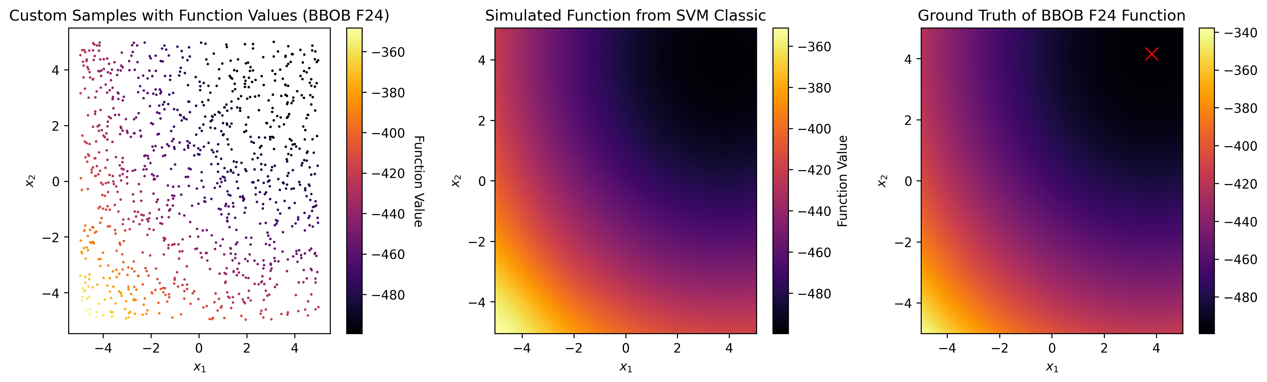

3.1 Classical Estimation Approach
Fully connected dense sequential NN
16 layers (8 neurons), ReLU activation
Fitted on 1000 random samples with MSE
PK
SVM
Neural Network
Classical SVM with RBF-Kernel
C=10, gamma=0.6 to avoid smoothing
Fitted on 1000 random samples
Fully connected dense sequential NN
16 layers (8 neurons), ReLU activation
Fitted on 1000 random samples with MSE

Slide 13
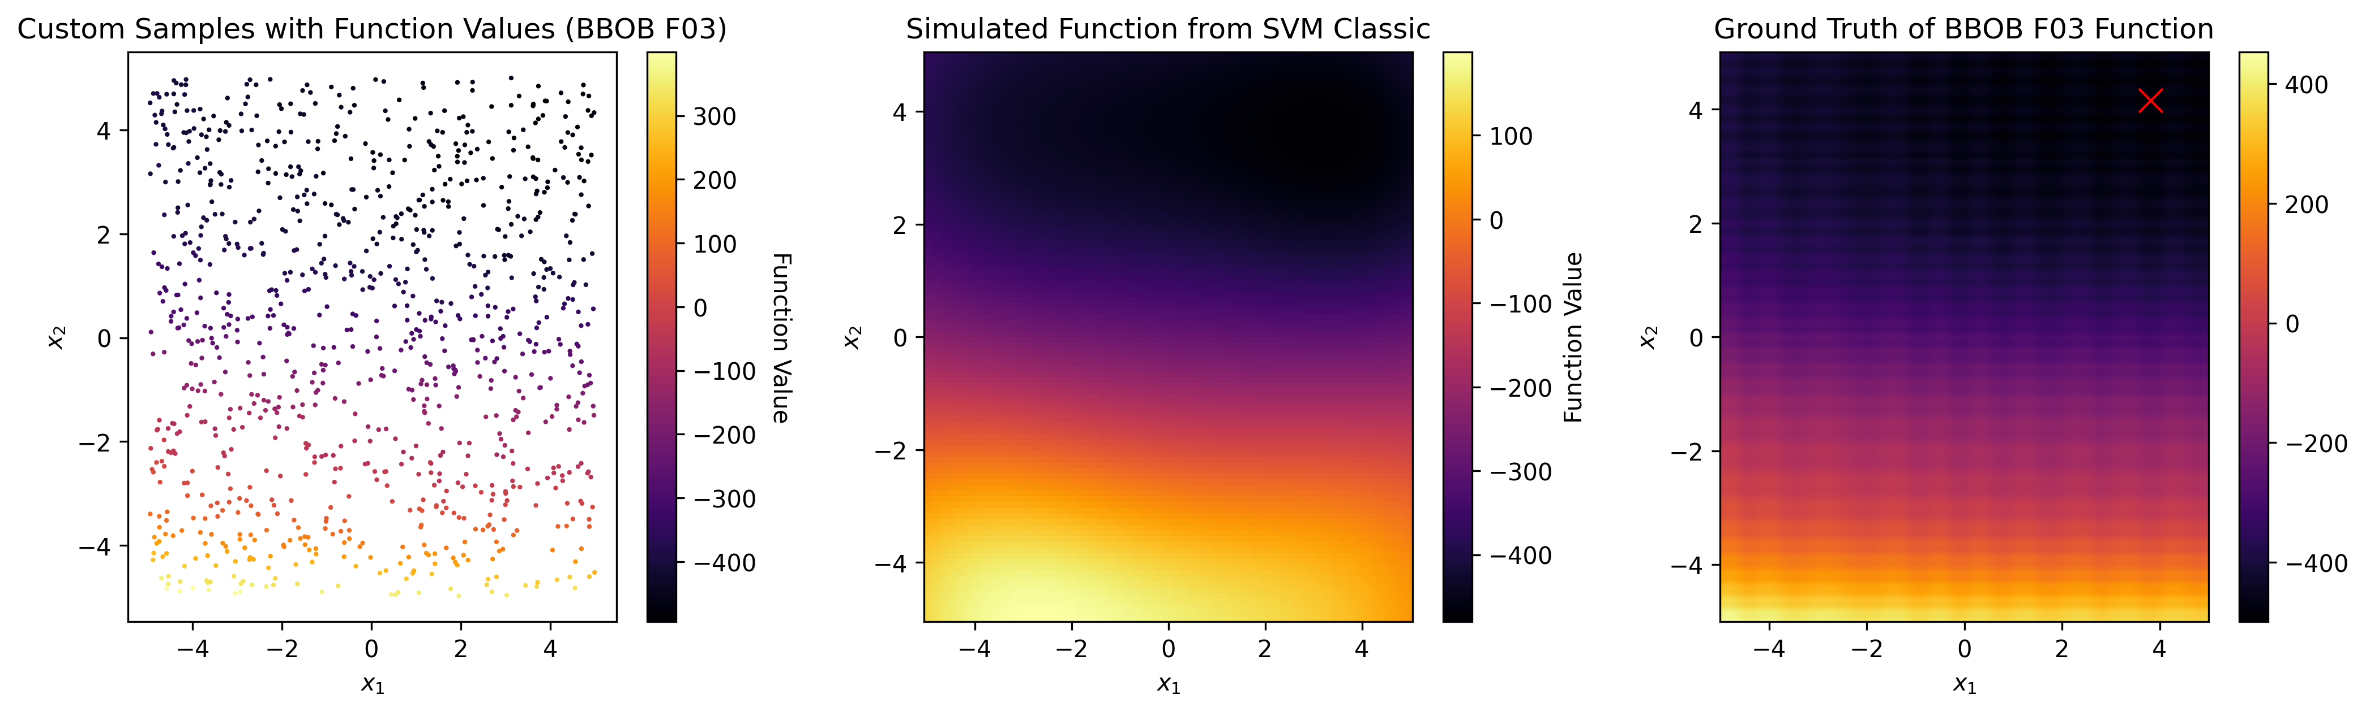
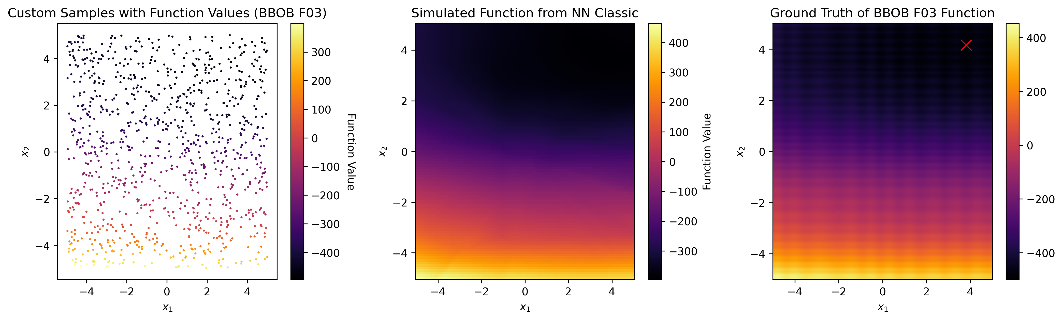
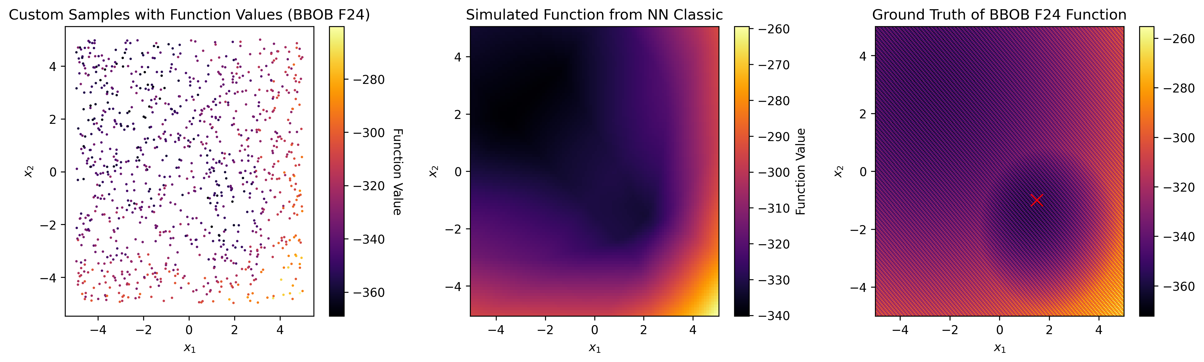
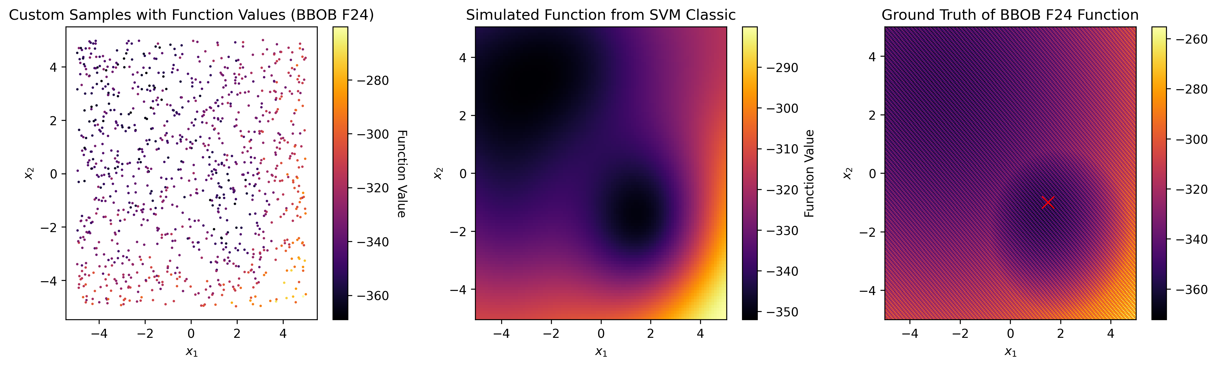
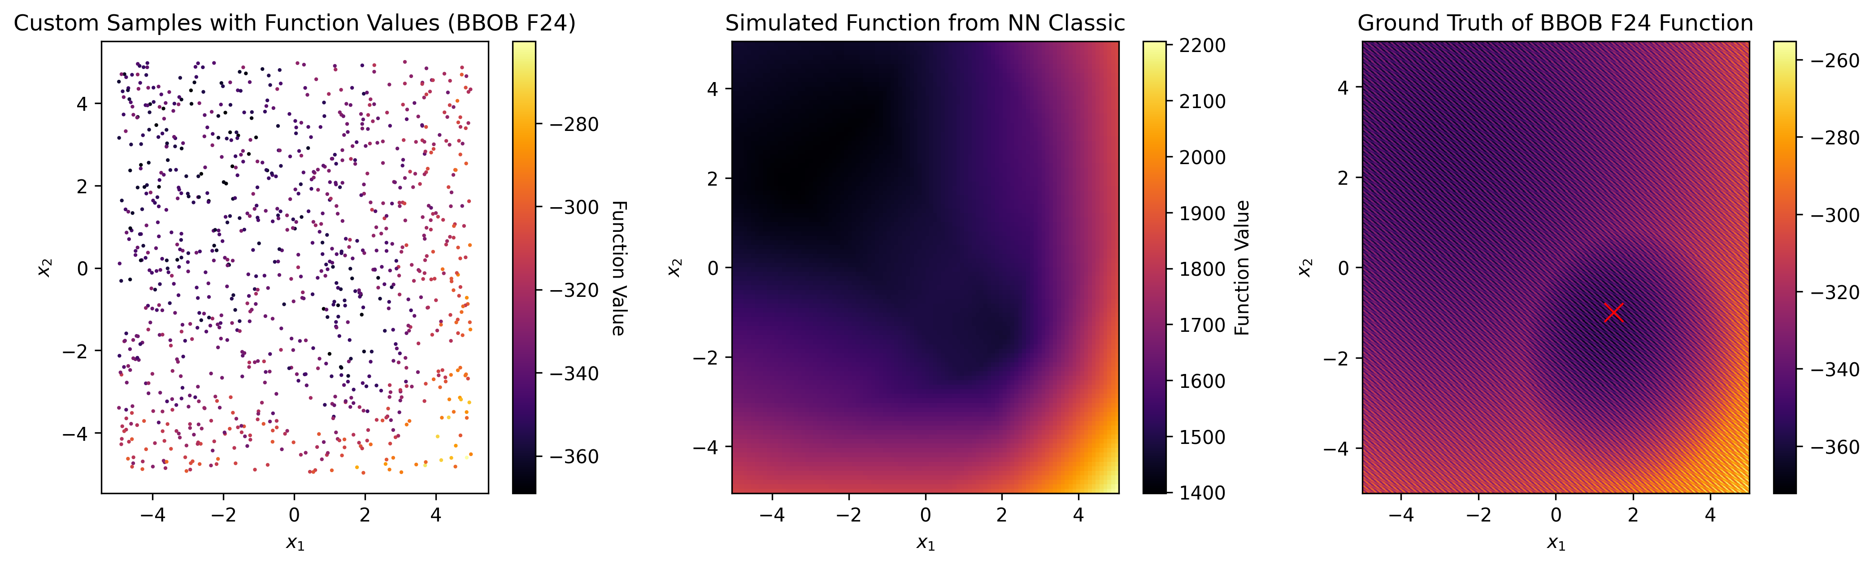
3.1 Classical Estimation Approach
PK
On first glance quite accurate simulation of BBOB F01
Global structure of F03 and F24 mostly captured
Local structure (ruggedness) not represented due to smoothing by the estimators
In general, SVMs seem marginally better

Slide 14
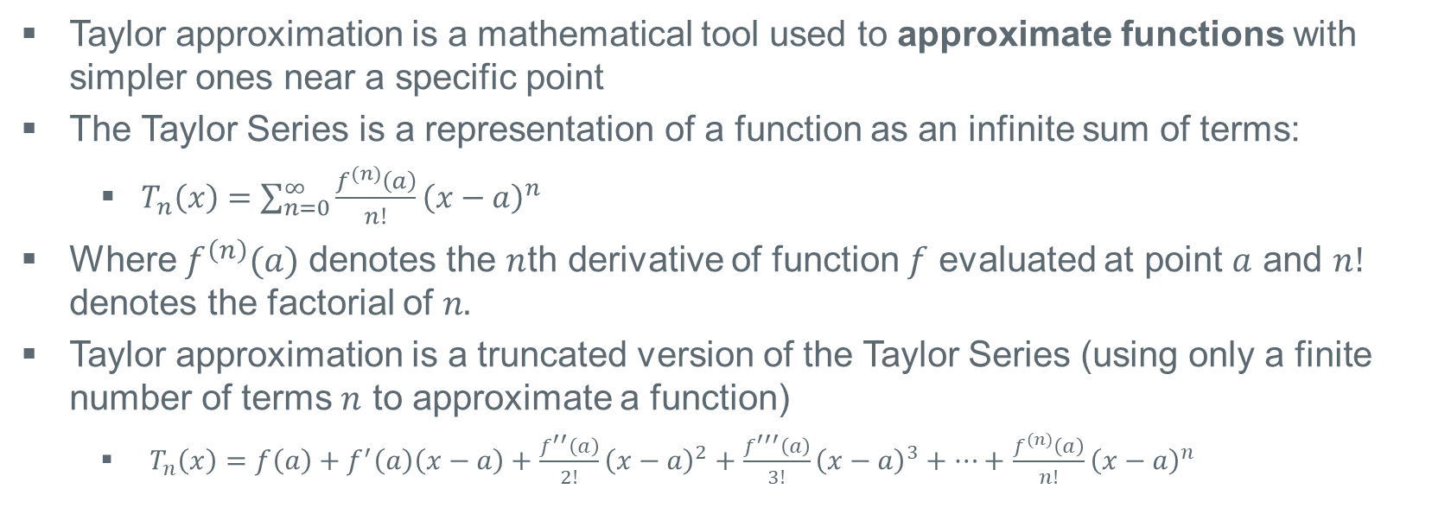
3.2 Proposed Solution: Taylor Approximation
PK
Taylor approximation is a mathematical tool used to approximate functions with simpler ones near a specific point
The Taylor Series is a representation of a function as an infinite sum of terms:
$T_{n}\left(x\right)=$ $\sum_{n=0}^{∞}{\frac{f^{(n)}\left(a\right)}{n!}{\left(x−a\right)}^{n}}$
Where $f^{\left(n\right)}(a)$ denotes the $n$th derivative of function $f$ evaluated at point $a$ and $n!$ denotes the factorial of $n.$
Taylor approximation is a truncated version of the Taylor Series (using only a finite number of terms $n$ to approximate a function)
$T_{n}\left(x\right)=f\left(a\right)+f^{′}\left(a\right)\left(x−a\right)+\frac{f^{′′}\left(a\right)}{2!}{\left(x−a\right)}^{2}+\frac{f^{′′′}\left(a\right)}{3!}{\left(x−a\right)}^{3}+…+$ $\frac{f^{(n)}\left(a\right)}{n!}{\left(x−a\right)}^{n}$
Thomas and Finney, 1996

Slide 15
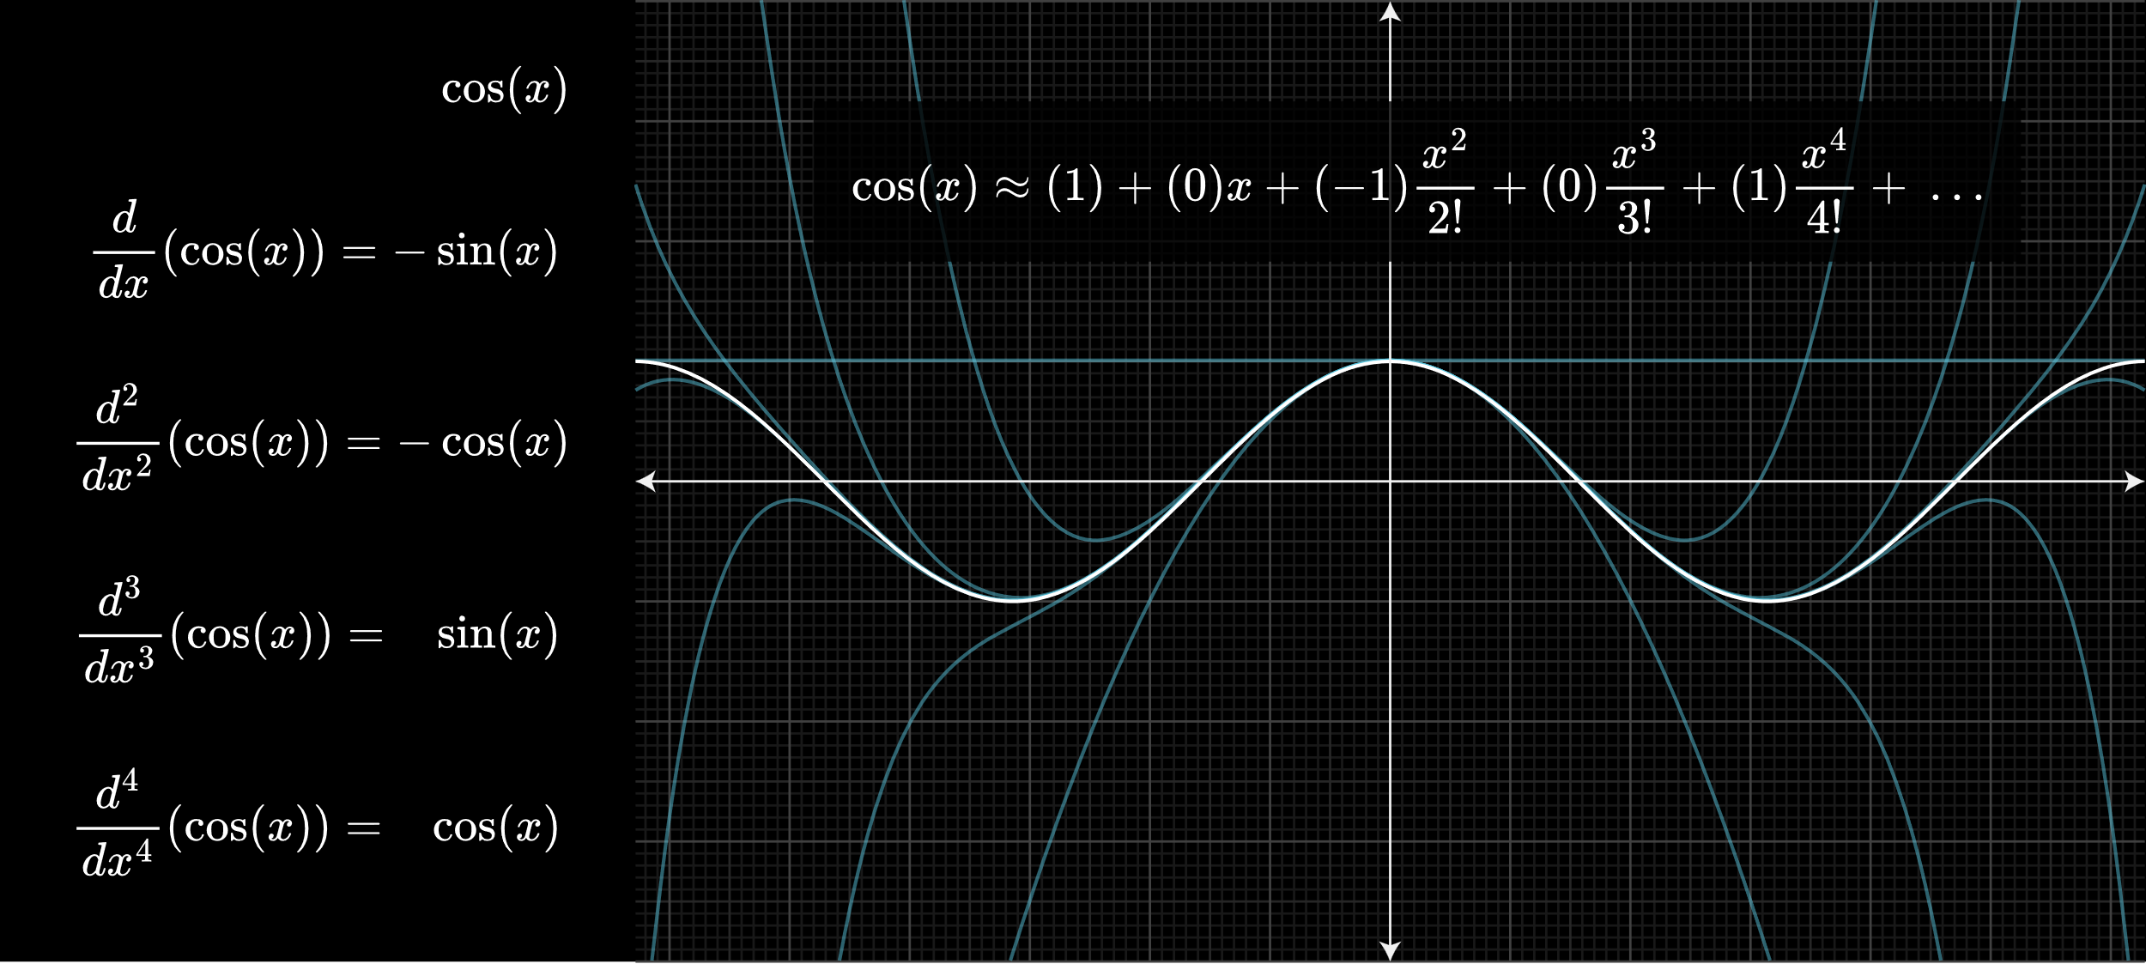
3.2 Proposed Solution: Taylor Approximation
PK
Idea: Use of gradient information for better simulation to capture local structure
https://www.3blue1brown.com/lessons/taylor-series (02.09.2023)

Slide 16

3.3 Gradients as a Feature
PK
Assumption: Derrivatives of groundtruth functions are easy to obtain i.e.
Physics simulation: position → speed → acceleration
Gradient approximation with neighboring points
Idea: Model is fed with gradients as inputs at training time
Fig.: Gra(a)F Zahl
Input:
x1 | x2 | df/dx1 | df/dx2 | d²f/dx1² | d²f/dx2² | y
… | … | … | … | … | … | …
https://twitter.com/drguidoknapp/status/1094550311480553479 (06.09.2023)

Slide 17
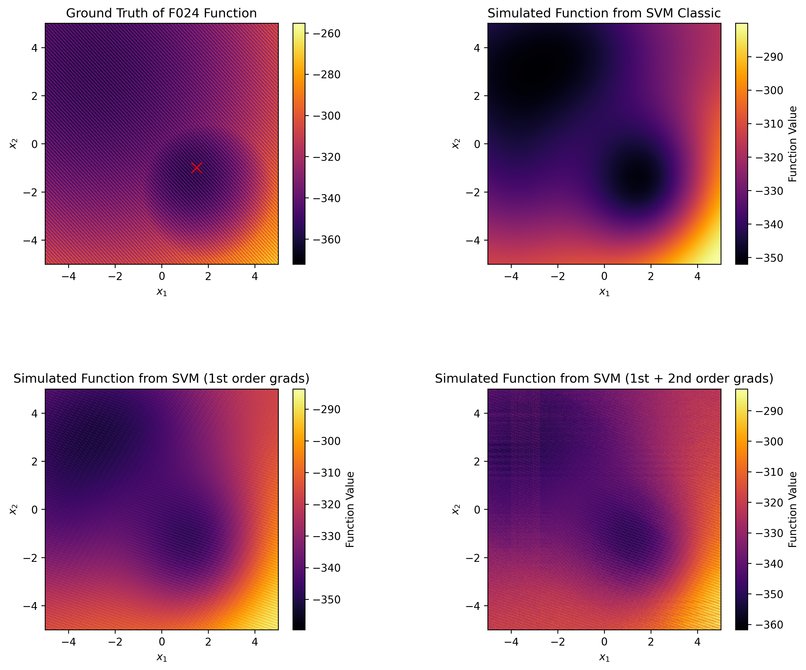
3.3 Gradients as a Feature
PK
Results with SVM seem promising
Problem: Gradients have to be available for every evaluated data point
For plot: Gradients obtained from the groundtruth used → no viable approach
Gradients of testfunctions not directly available

Slide 18
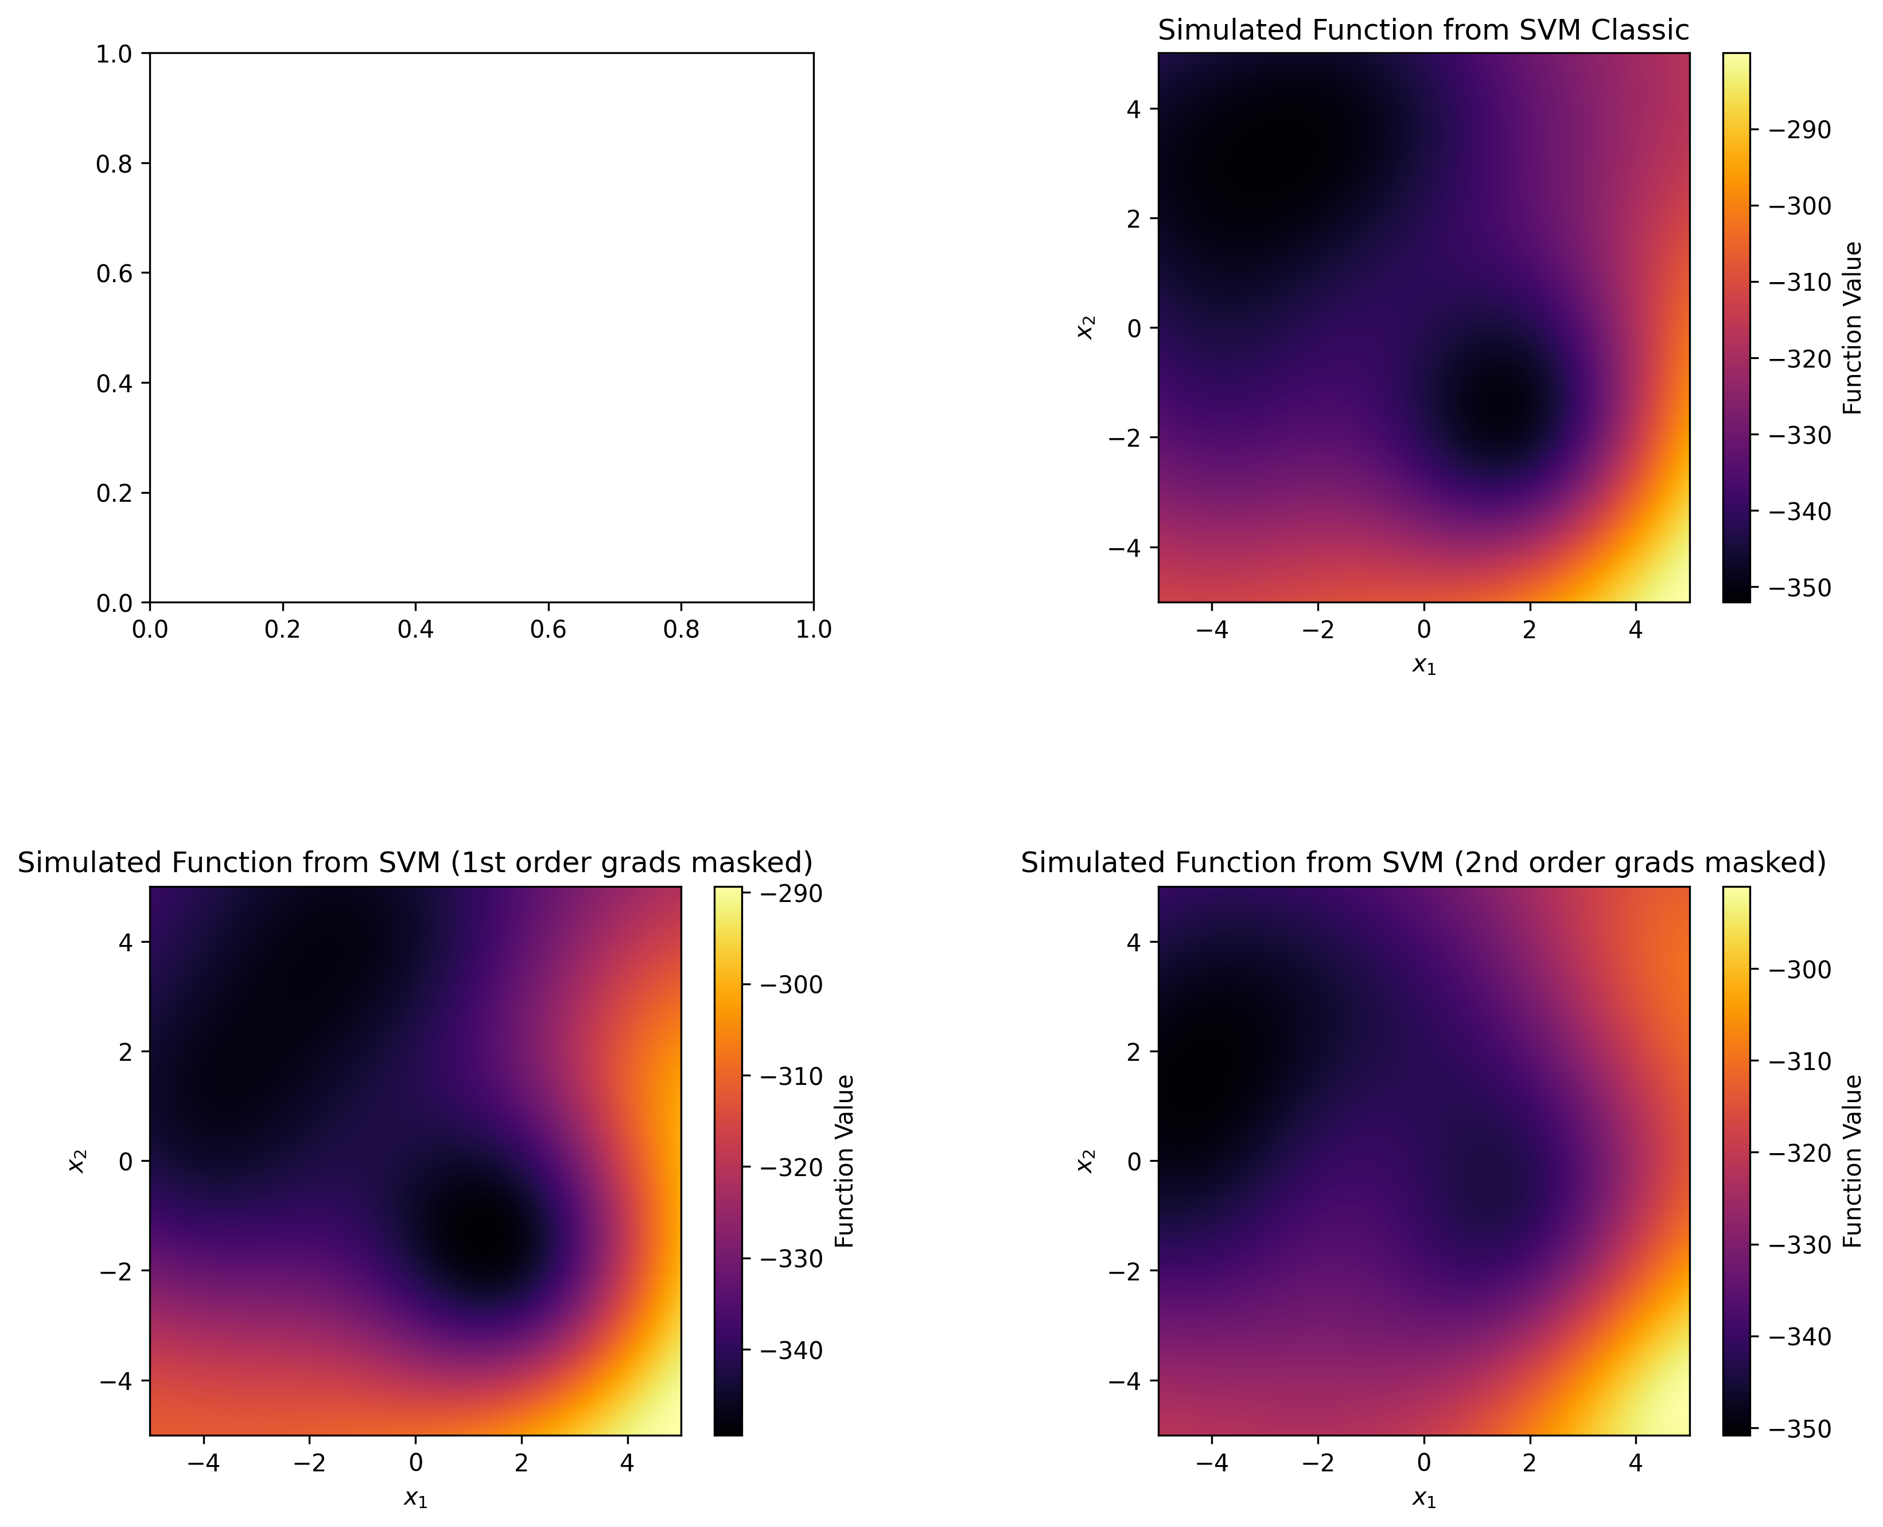
3.3 Gradients as a Feature
PK
Masking Gradients
Mask out a specified random share of the input gradients during training (with 0s or mean)
Feed an array of only the mask values during inference
Example – 50% masked with 0s:
but: nearly no information is learned from the masked gradients, rather smoothing effect

Slide 19
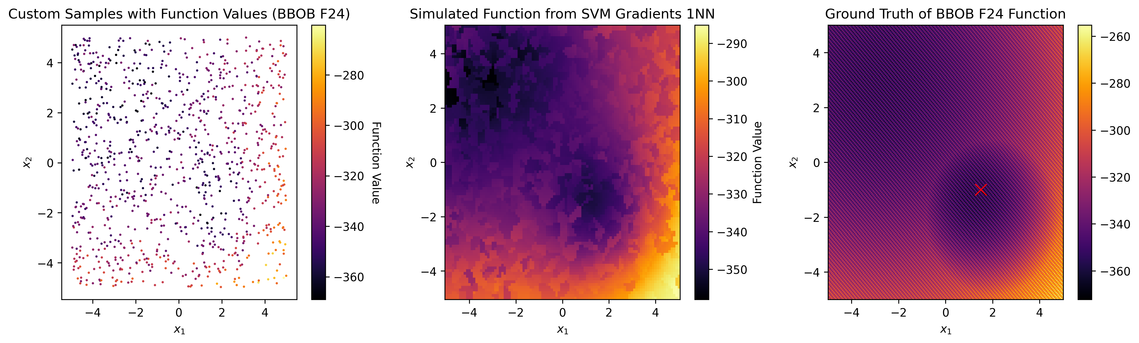
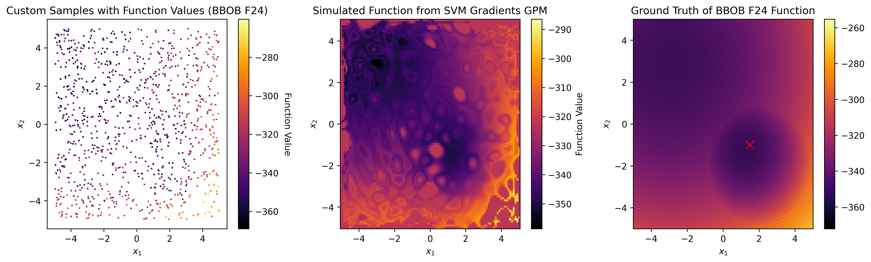
3.3 Gradients as a Feature
TZ
Estimating Gradients
Nearest Neighbor
GPM Gradient Estimator
Using a Gaussian Process Regressor trained on Coordinate-Gradient-Pairs
Taking the gradients of the nearest neighbor in training set

Slide 20
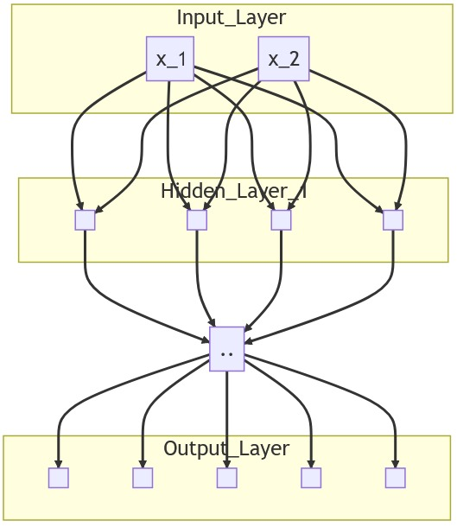
3.4 Multioutput Regression with Gradients
TZ
Idea
NN is trained on predicting gradients of 1st and 2nd order
NN implicitly uses gradient information for prediction of y
Additional information to capture local structure
… … …
Results
No sufficient results as gradient influence is difficult to balance
y
1st order gradients
2nd order gradients

Slide 21

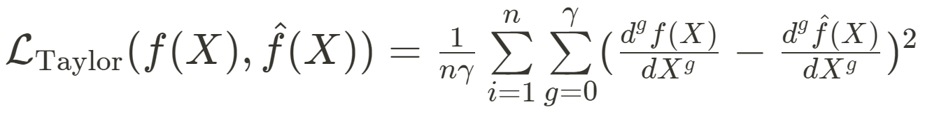
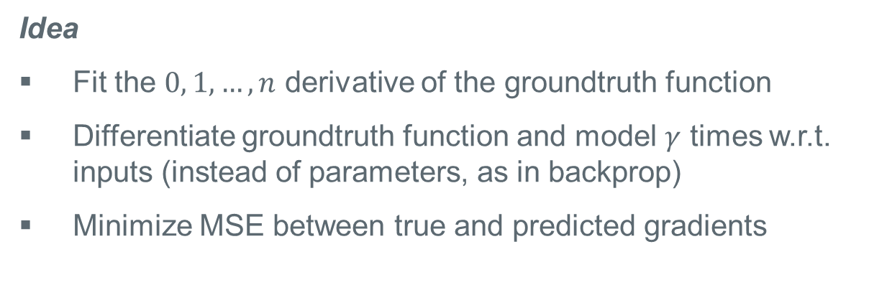
3.5 Taylor-Loss: Gradient-based Loss Function
TZ
„Nicht zu verwechseln mit:“
Idea
Fit the $0, 1,…,n$ derivative of the groundtruth function
Differentiate groundtruth function and model $γ$ times w.r.t. inputs (instead of parameters, as in backprop)
Minimize MSE between true and predicted gradients
Our Loss function
Fig.: Taylor Swift
https://variety.com/wp-content/uploads/2023/08/BUK_8738-e1691715895373.jpg (01.09.2023)

Slide 22

3.5 Taylor-Loss: Gradient-based Loss Function
TZ
Results
Visually promising results obtained for BBOB F01
Challenge: reengineering functions in a differentiable manner
Differentiable implementation for F03 and F24 not available
Simulation not implemented for F03 and F24
For future experiments, a more performant implementation of the loss function is required

Slide 23
04 EVALUATION
TZ
Graphical evaluation
Evaluation with optimizers
Metric-based evaluation

Slide 24

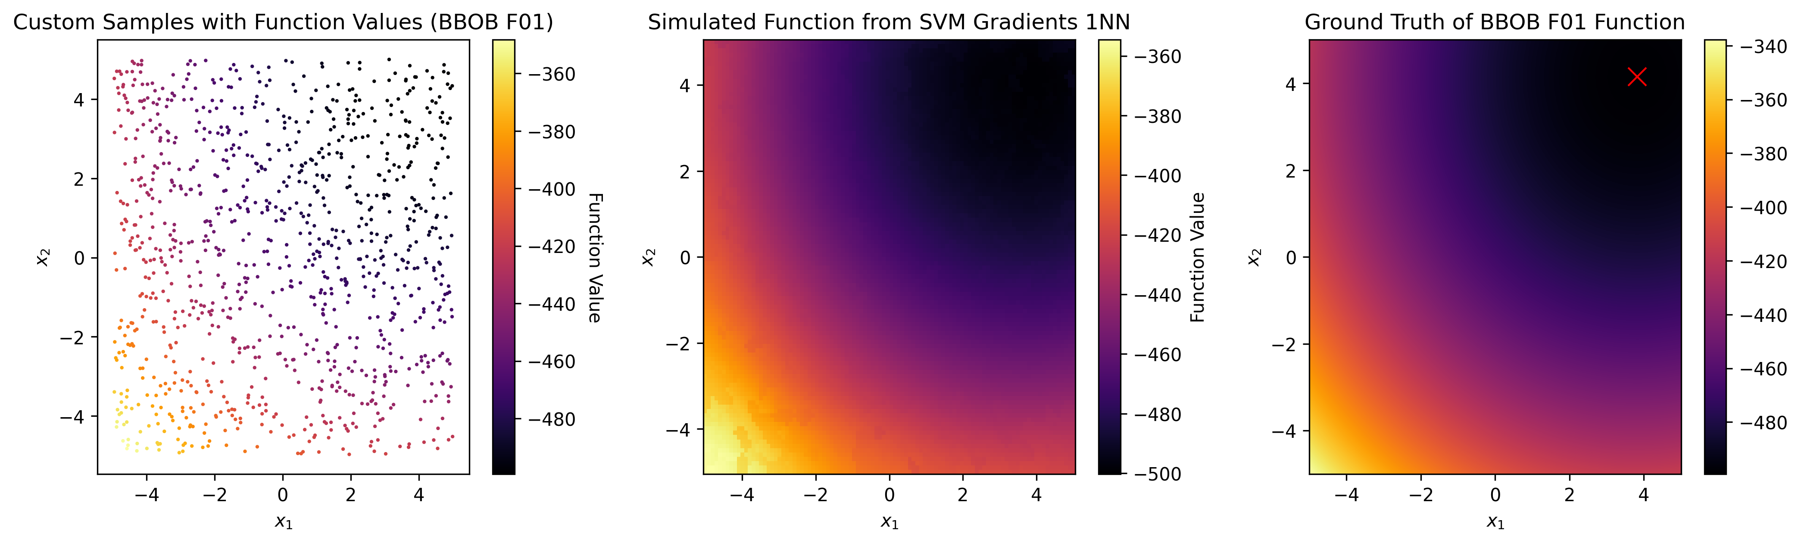

4.1 Graphical Evaluation
TZ
BBOB F01
BBOB F01
visually, most models can simulate F01 quite well
(incorrect) ruggedness introduced by models with estimated gradients as input

Slide 25
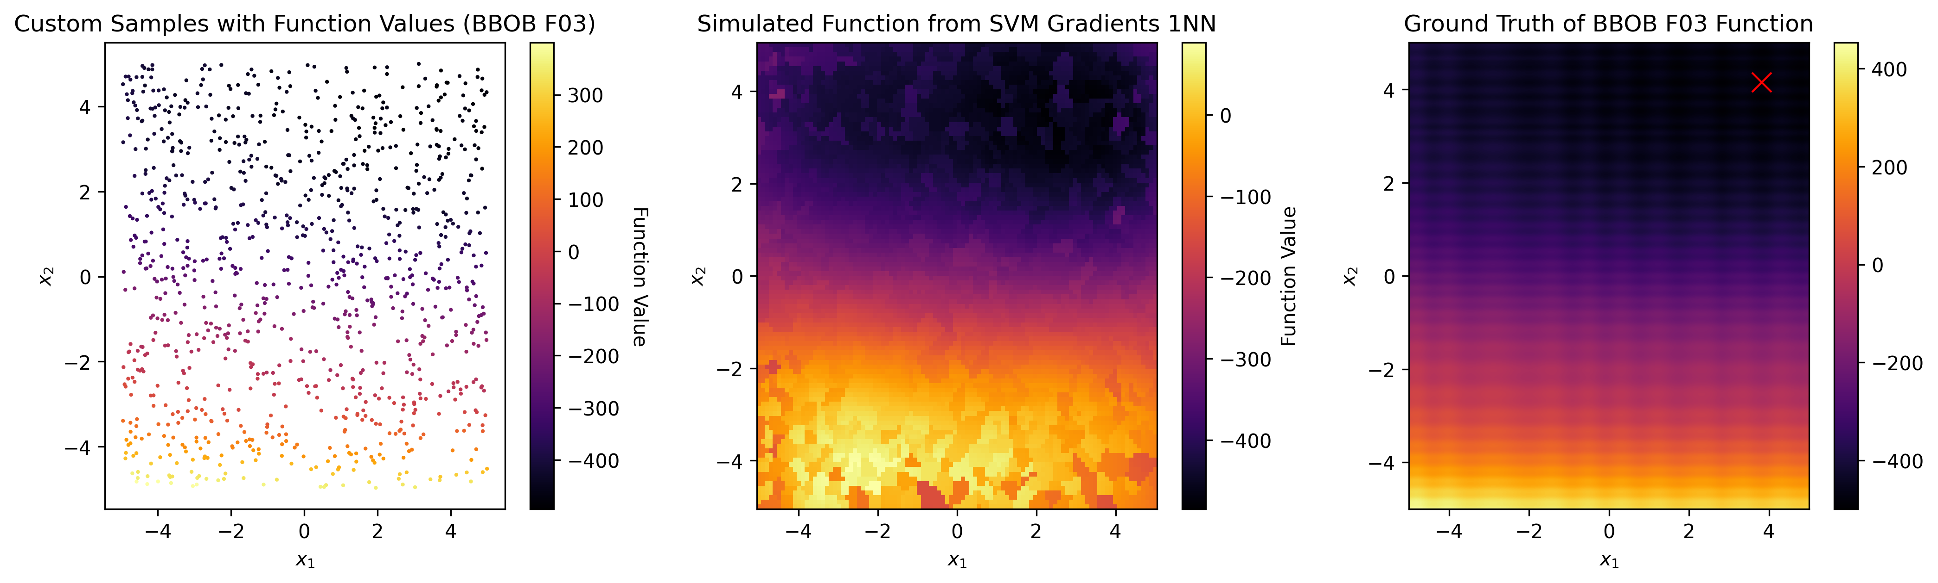
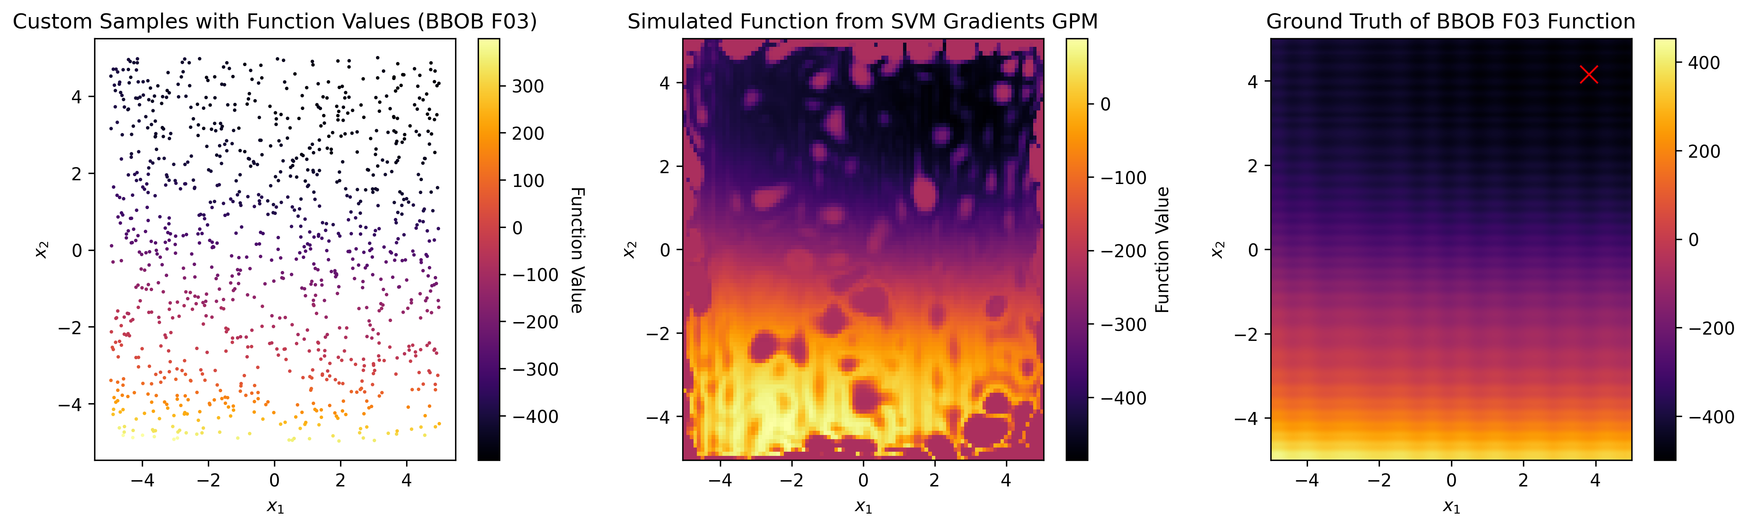
4.1 Graphical Evaluation
TZ
BBOB F03
Global structure is captured by classic models
Models with estimated gradients introduce extreme local, incorrect ruggedness

Slide 26
4.1 Graphical Evaluation
TZ
BBOB F24
Global structure is captured by classic models
Models with estimated gradients introduce extreme local, incorrect ruggedness

Slide 27
4.1 Graphical Evaluation
TZ
Limitations of Graphical Evaluation
Qualitative (and subjective) assessment
Limited to max. 2D data

Slide 28
4.2 Optimization-based Evaluation
MS
Comparing optimization curves for testfunctions and groundtruth
Evaluation of „real“ application of the testfunctions
Three different optimizers:
Random Search
Gradient Descent
Differential Evolution
Evaluation over 20 trials (mean, IQR)
Notes:
- repräsentiert den eigentlichen Anwendungsfall

Slide 29
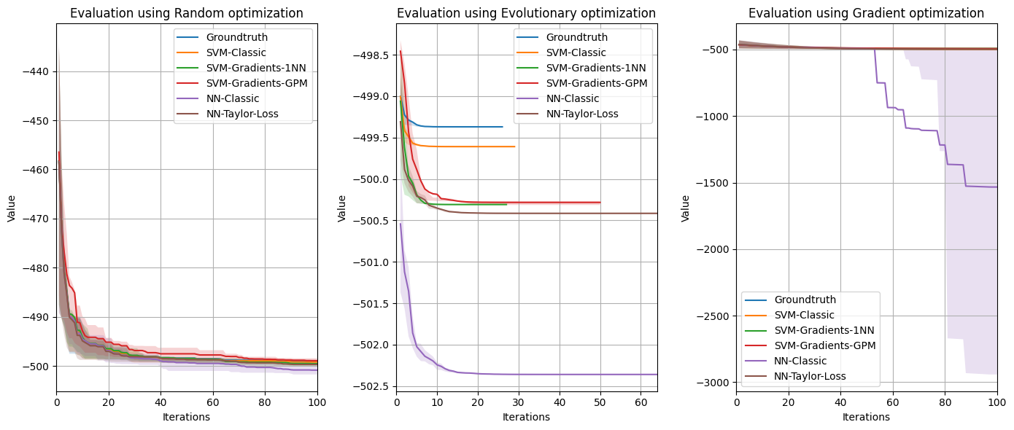
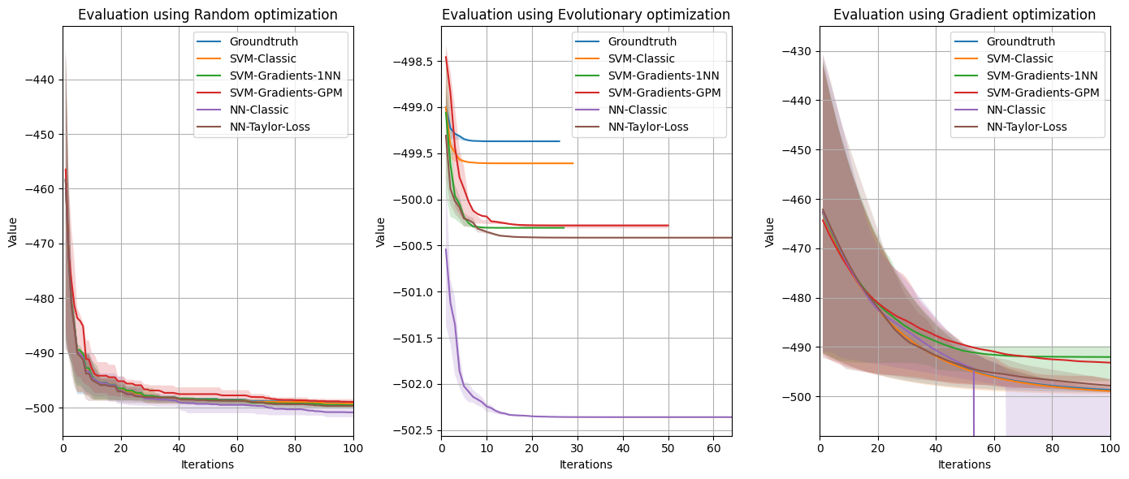
4.2 Optimization-based Evaluation
MS
BBOB F01
Notes:
Random Search findet die Optima meist nach 40-60 Iterationen

Slide 30
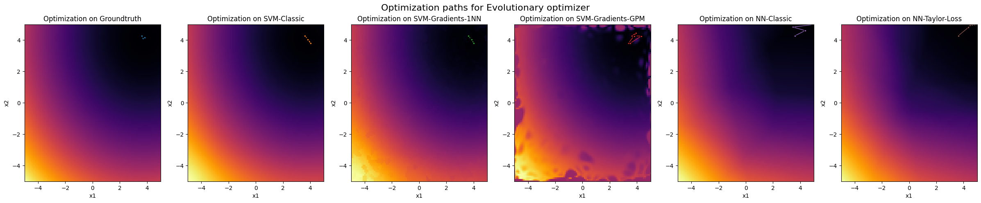

4.2 Optimization-based Evaluation
MS
BBOB F01
Evolutionary
Similar optimization paths for classic models
Gradient problems with rugged testfunctions
Problems with optimum for NN classic
Limitation: only one trial is visualized here!
Gradient Descent

Slide 31
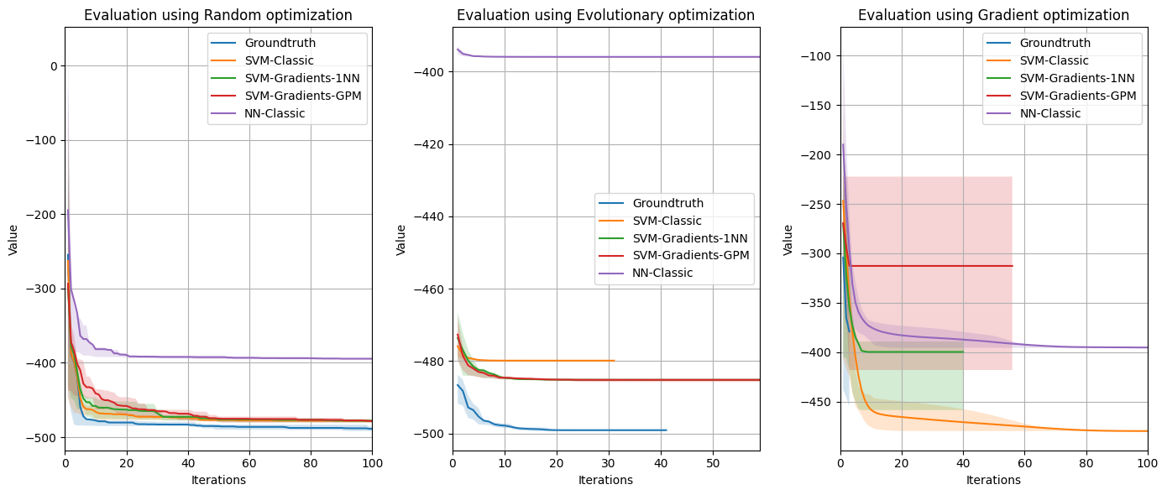
4.2 Optimization-based Evaluation
MS
BBOB F03

Slide 32
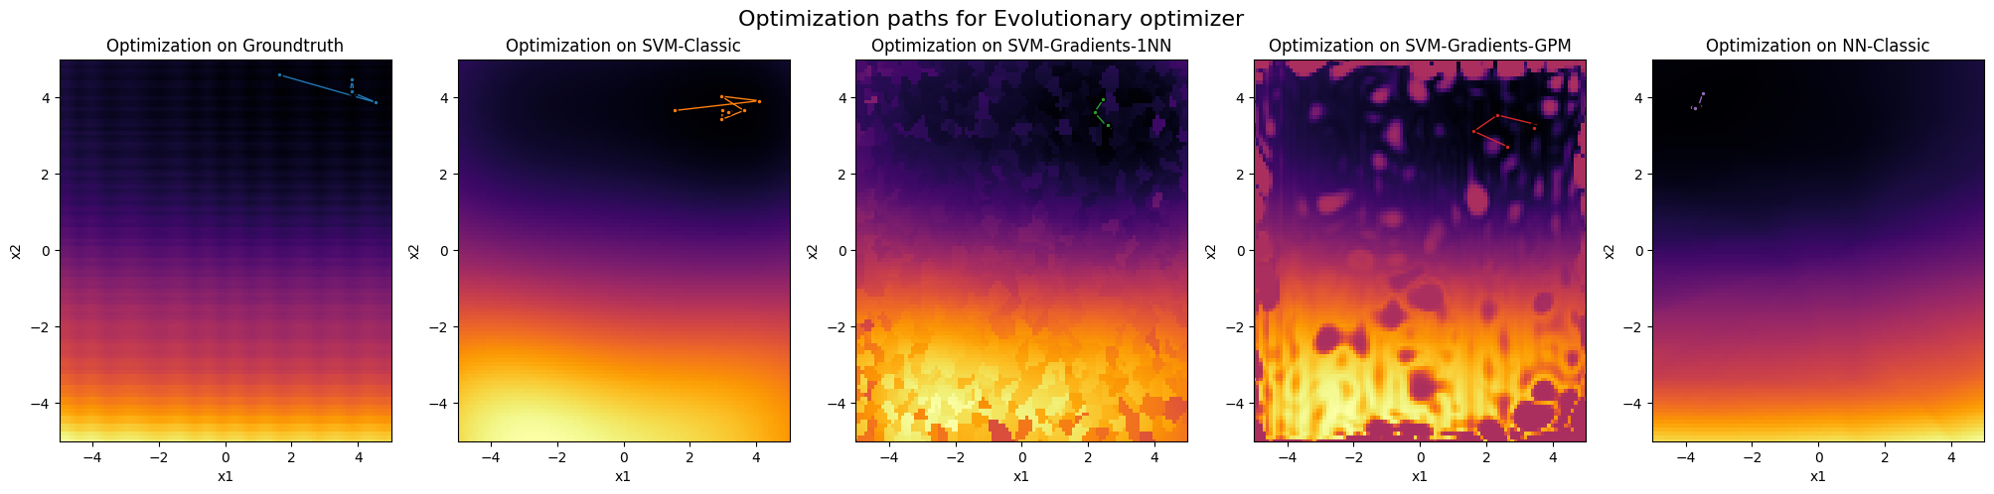

4.2 Optimization-based Evaluation
MS
BBOB F03
Evolutionary
GD struggles on rugged groundtruth
Optimization on classic testfunctions is too smooth
GD is stuck on a local minimum
Gradient Descent

Slide 33
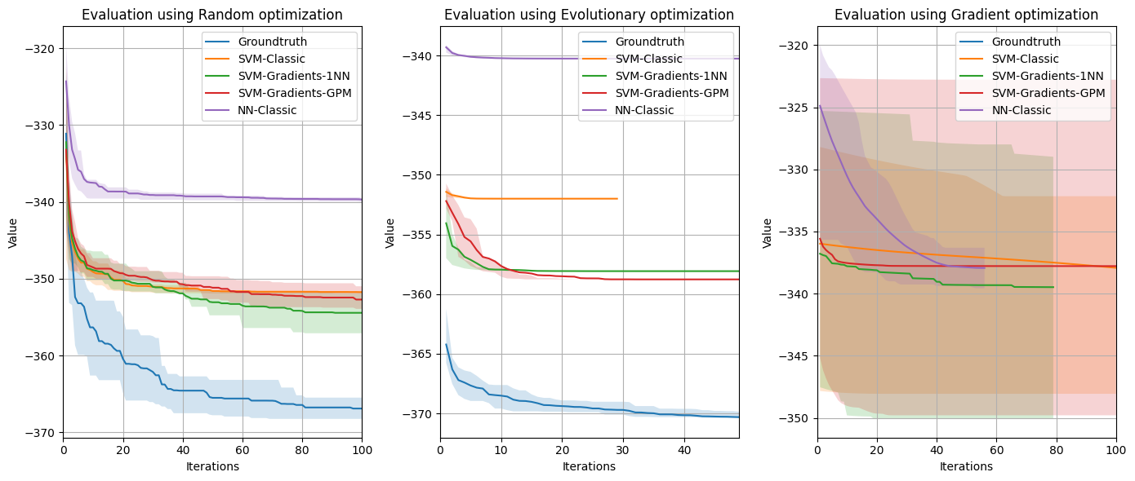
4.2 Optimization-based Evaluation
MS
BBOB F24

Slide 34
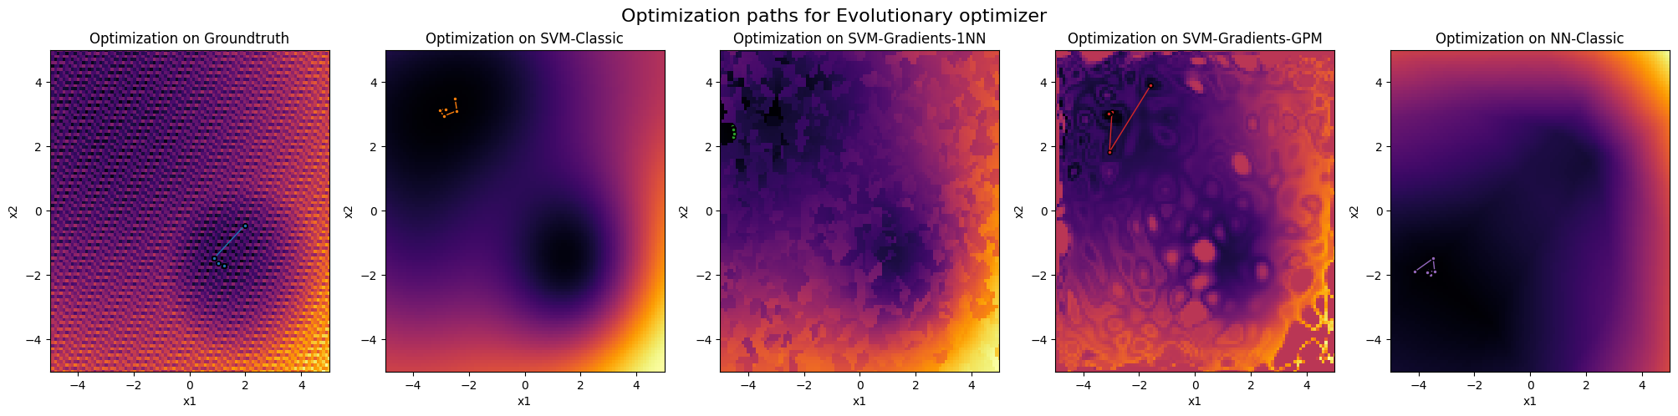
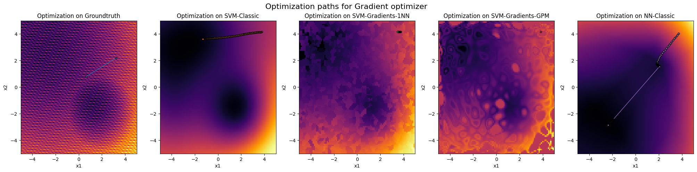
4.2 Optimization-based Evaluation
MS
BBOB F24
Evolutionary
GD stuck during optimization
Wrong optimum found for SVM
For classic problem, the optimum is found too smoothly
For models with estimated gradients, the optimizers are stuck on discrete plateaus
Gradient Descent
BUT: Still qualitative!

Slide 35
4.3 Metric-based Evaluation
TH
Spearman‘s rho between groundtruth and testfunction
Pearson‘s r between groundtruth and testfunction
no. optimizer iterations
coordinates of the found optimum
y-value of the found optimum
MSE between optimization curves of groundtruth and test function
Correlation r between optimization curves of groundtruth and test function
Comparison of the functions through correlations
Quantification of the optimization curves

Slide 36
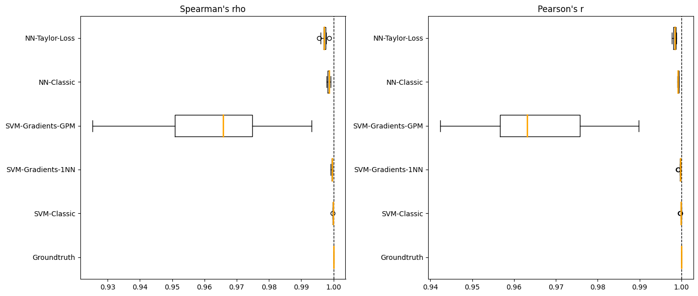
4.3 Metric-based Evaluation
TH
BBOB F01
Comparison of the functions through correlations

Slide 37
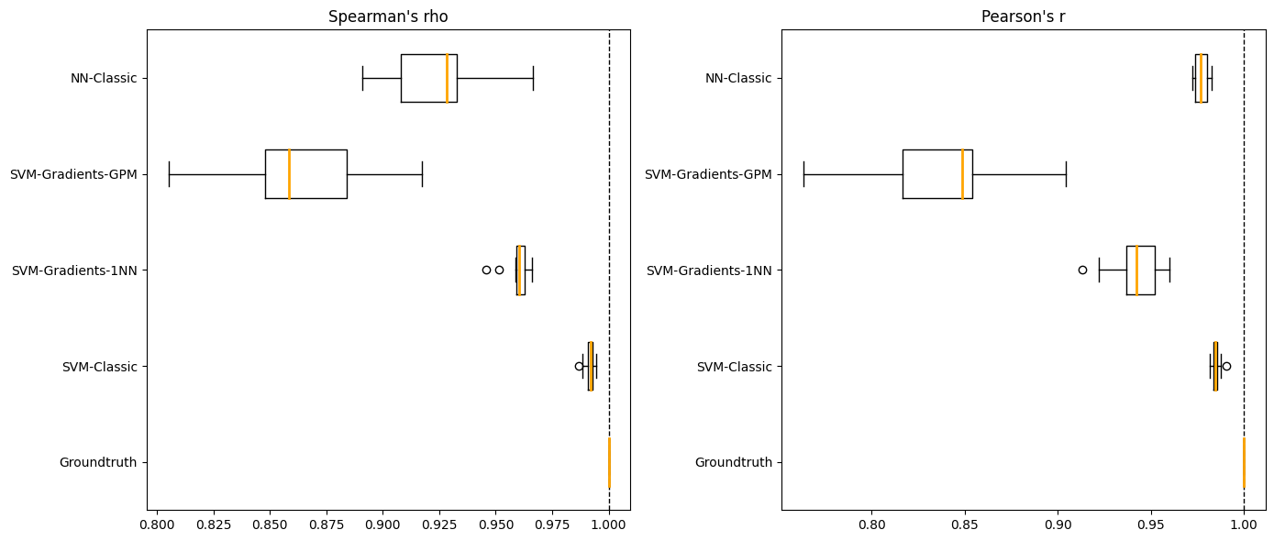
4.3 Metric-based Evaluation
TH
BBOB F03
Comparison of the functions through correlations

Slide 38
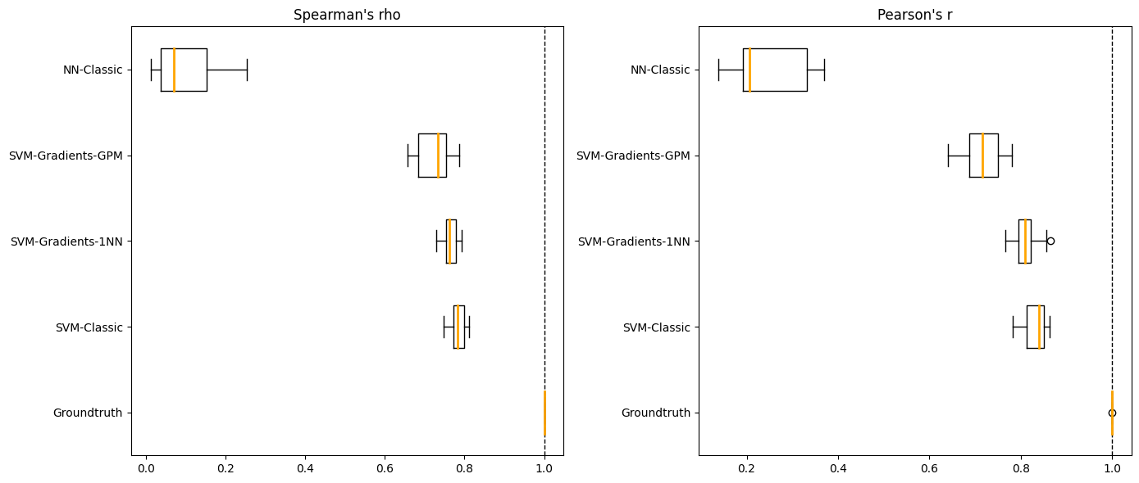
4.3 Metric-based Evaluation
TH
BBOB F24
Comparison of the functions through correlations

Slide 39
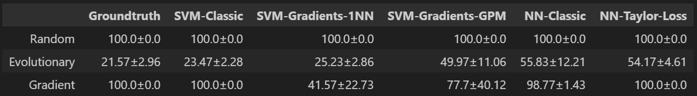
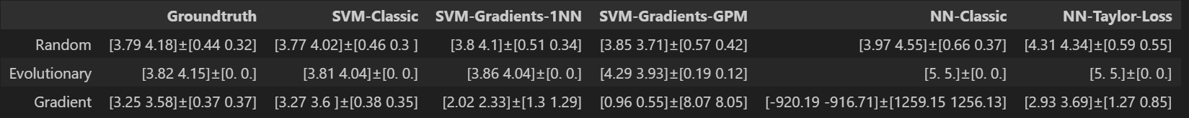
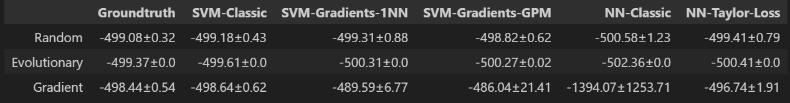
4.3 Metric-based Evaluation
TH
BBOB F01
Quantification of the optimization curves
#Iterations
Location of optimum
Optimum value

Slide 40
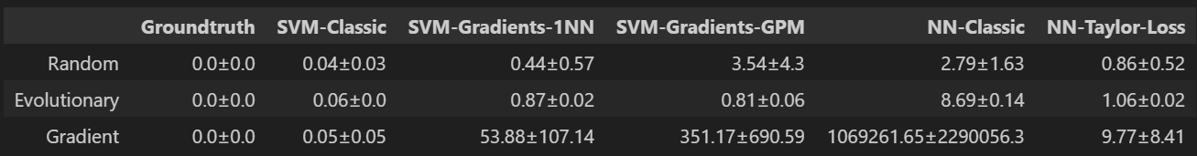
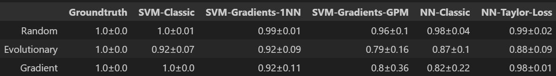
4.3 Metric-based Evaluation
TH
BBOB F01
Quantification of the optimization curves
MSE of optim curves
Correlation r of optim curves

Slide 41
4.3 Metric-based Evaluation
TH
BBOB F03 & F24
Quantification of the optimization curves
For F03 and F24, the conclusions from above can be similarly confirmed with our metrics

Slide 42
05 Conclusion
TH

Slide 43
5.1 Results
TH
F01 can be simulated accurately by classical models, (SVM with RBF-Kernel, NN with MSE)
For F03 and F24, the global structure is captured, but not the regular local structure
Taylor approximation and gradients are theoretically a promising approach
Taylor loss delivers promising results on F01, implementation fails on F03 and F24
Evaluation concepts developed to prove results
Promising results with gradients from ground-truth not reproducible in realistic scenario

Slide 44
TH
5.1 Results – Objective Evaluation
Difficulty: for F01✅, for F03 and F24❌
Costs: NNs (and also SVMs) fast inference✅, gradients little more expensive
Diversity: not explicitly tested, but all models are diverse✅
Flexibility: only for simple model classes ❔
Relevance: depends on real-world relevance of BBOB-functions and difficulty ❔

Slide 45
5.2 Limitations
TH
Influence of sample size not analyzed
Experiments only with 2 input dimensions
Assumption: Availability/estimation of gradients
Open question: Leakage of function values via gradients?
→ Interesting approaches which are yet to be practically proven through optimized implementations and further engineering efforts

Slide 46
SOURCES
[Thomas and Finney 1996] Thomas, George B. Jr.; Finney, Ross L. (1996), Calculus and Analytic Geometry (9th ed.), Addison Wesley
[Zaefferer and Fischbach 2017] Zaefferer, Martin and Fischbach, Andreas and Naujoks, Boris and Bartz-Beielstein, Thomas: Simulation-Based Test Functions for Optimization Algorithms. In: Proceedings of the Genetic and Evolutionary Computation Conference, 2017, pp. 905–912

Slide 47
Back-Up

Slide 48
4.2 Optimization-based Evaluation
MS
BBOB F01

Slide 49

4.2 Optimization-based Evaluation
MS
BBOB F03
GD begins to struggle on rugged groundtruth
Optimization on classic testfunctions is too smooth compared to the groundtruth
Note: NN test function is mirrored
For model with estimated gradients, the GD is stuck on discrete plateau

Slide 50

4.2 Optimization-based Evaluation
MS
BBOB F24
On groundtruth: RS and GD do no find optimum, GD stuck
Wrong optimum found for SVM
Note: NN test function is again mirrored and optimum is found too smoothly
For models with estimated gradients, the optimizers are stuck on discrete plateaus
BUT: Still qualitative!

Slide 51
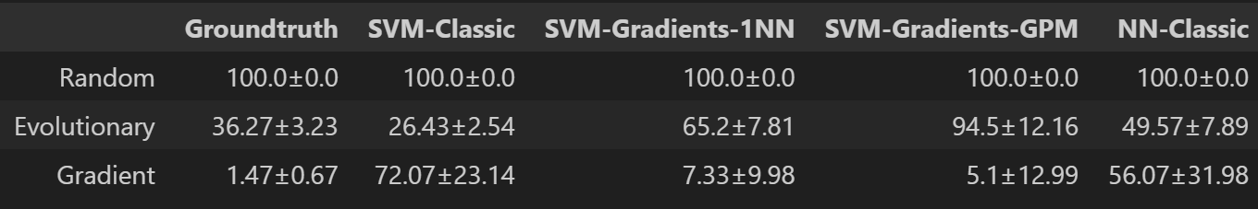
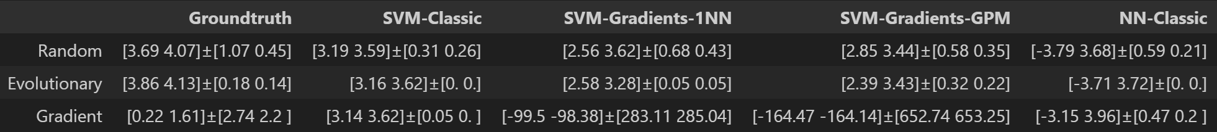
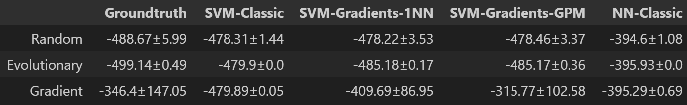
4.3 Metric-based Evaluation
TH
BBOB F03
Quantification of the optimization curves
#Iterations
Location of optimum
Optimum value

Slide 52
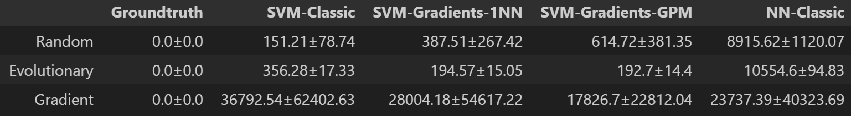
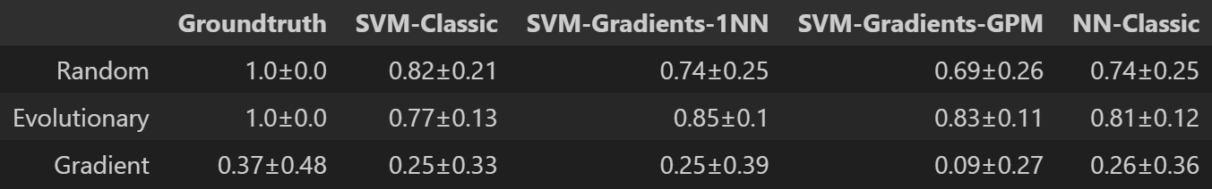
4.3 Metric-based Evaluation
TH
BBOB F03
Quantification of the optimization curves
MSE of optim curves
Correlation r of optim curves
!

Slide 53
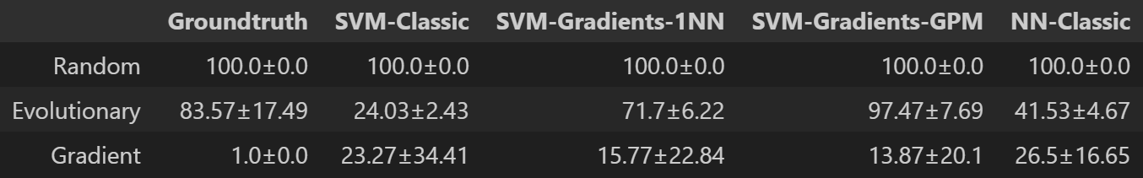
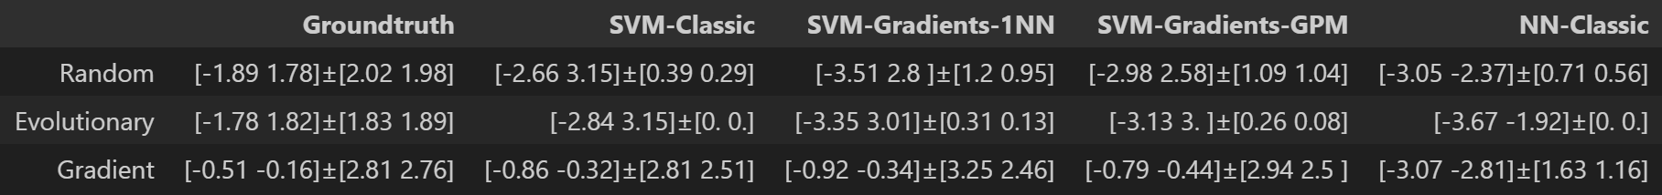
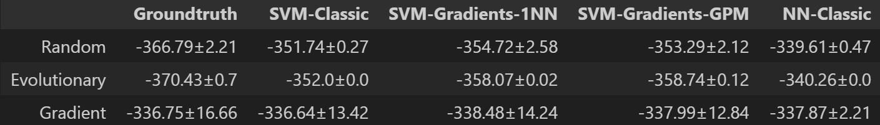
4.3 Metric-based Evaluation
TH
BBOB F24
Quantification of the optimization curves
#Iterations
Location of optimum
Optimum value

Slide 54
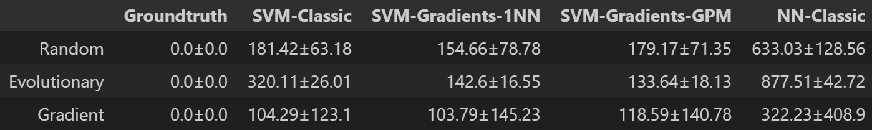
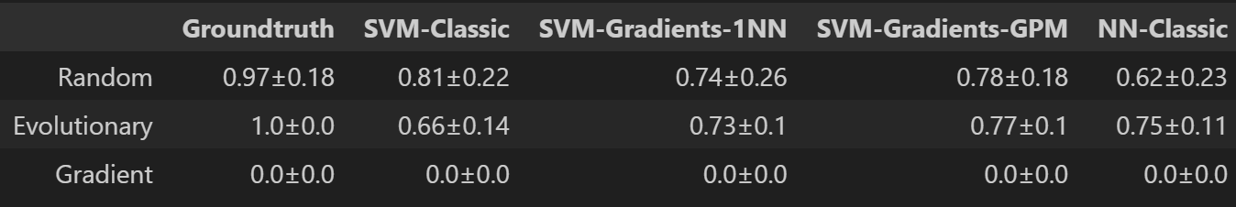

4.3 Metric-based Evaluation
TH
BBOB F24
Quantification of the optimization curves
MSE of optim curves
Correlation r of optim curves
!

